Slide 1
5DH & EPT2020 DCDC – RFQ
Tobias Grote, Mario Schroeder, Peter Karabinos
CW1740

Slide 2
5DH DCDC main requirements
Electrical Requirements
Power:
2200W @60C (160A at 14V on the output)
1680W @65C (120A at 14V on the output)
Output Voltage:
Range: 7.5...16V
nominal: 14V
Efficiency:
90% @ 11% Pnom
95% @ 33% Pnom
91% @ 66% Pnom
90% @ 100% Pnom
Input Voltage - two HW variants:
DCDC_HEV: 140V…285V (112V..296V) Vnom: 225V
DCDC_PHEV: 240V…420V (200V..430V) Vnom : 345V
High speed CAN interface: 500kbps
Overvoltage, Overcurrent, Reverse Polarity Protections
Overheating Protection
Self Diagnostics
Mechanical Requirements
Dimensions: <310mm x 185mm x 34mm
Weight: < 2.5kg
Volume: <1.9 liter
Cooling
Water cooling
Operating Temperature:
-30°C – +85°C (ambient)
-30°C – +65°C (coolant)
Storage Temperature:
-40°C – 100°C
Tightness: IP67 + IPx9K
Pressure drop: 40mBar@50°C & 8l/min flowrate

Slide 3
Electrical design

Slide 4
Converter Topology
Boost converter + LLC half bridge resonant converter
5DH & EPT DCDC160
Diode rectification
Covers wide in-/output voltage range → One DCDC for HEV and PHEV is feasible (5DH)
Low EMI

Slide 5
Detailed Block Diagram
DCDC with diode rectifier

Slide 6
Efficiency
Efficiency curves
Conditions (5DH)
Vin_PHEV = 345V
Vin_HEV = 225V
Vout = 14V
Efficiency [%]
6

Slide 7
Mechanical design

Slide 8
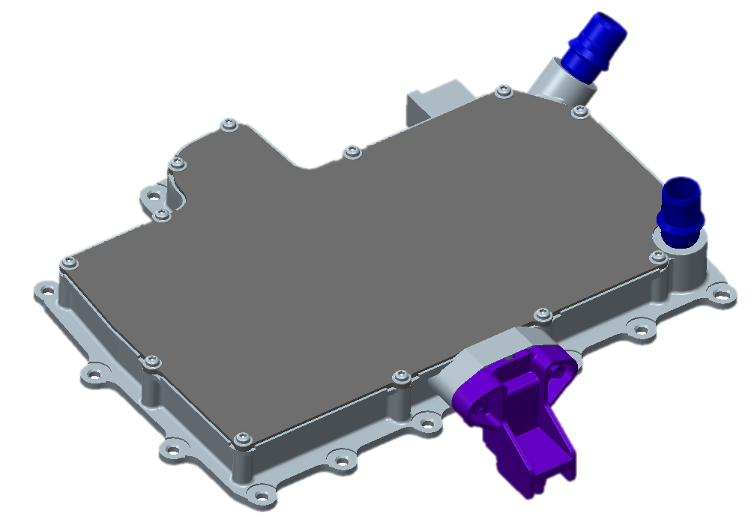
Mechanical design
Housing dimensions:
L x W x H (mm) : 310x225x34 (w/o connectors)
L x W x H (mm) : 310x185x34 (w/o connectors & input wiring section)
Volume : 1.9 l
34 mm
310mm
185mm

Slide 9
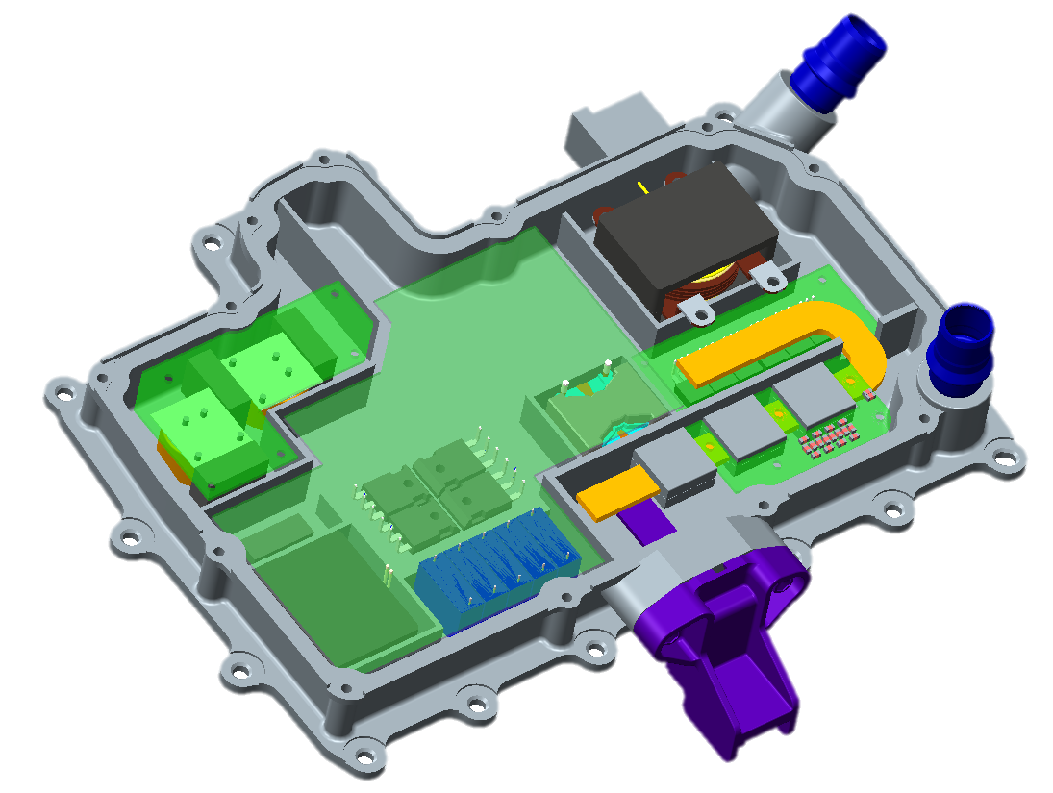
Mechanical design 5DH
POWER & CONTROL
BOARD
WATER COOLING INLET
HV & SIGNAL WIRES INPUT
OUTPUT BUSBAR
FIPG SEALING SURFACE
WATER COOLING
OUTLET
INPUT EMI FILTER
OUTPUT EMI FILTER
OUTPUT CONNECTOR

Slide 10
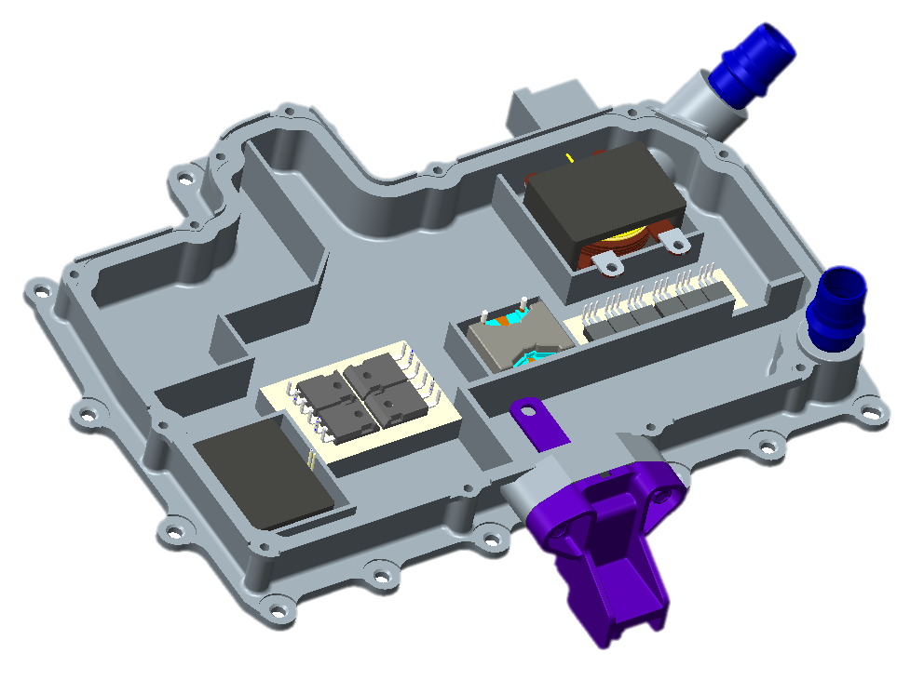
Mechanical design 5DH
MAGNETICS POTTED
IN CHASSIS
TO247 BONDED WITH
BONDPLY INSULATOR
TO220 BONDED WITH
BONDPLY INSULATOR

Slide 11
Technical Compliance EMC

Slide 12
EMC
EMC measures:
Two stage input EMI filter
Two stage output EMI filter
Mechanical shielding
Boost converter comprises good input EMC due to inductor on input side
LLC converter comprises good EMC due to sinusoidal waveforms and varying switching frequency
➔ Low EMI
➔ Proposed converter topology + input & output EMI Filter + shielding exhibit good EMC.

Slide 13
New!
EMC
Switching Frequencies:

Slide 14
EMC
Input filter parameter:
 | Vin_min | Pout_max | Iin_max*
5DH HEV | 140 V | 2240 W | 17.8A
5DH PHEV | 240 V | 2240 W | 10.4 A
EPT 160A | 240 V | 2400 W | 11.1 A
EPT 250A | 240 V | 3750 W | 17.4A
5DH HEV and EPT 250A have similar max. input current
5DH PHEV and EPT 160A have similar max. input current
For similar input current filter components with equal current rating could be used
* Calculated with 90% efficiency

Slide 15
Technical Compliance Electrical & functional safety

Slide 16
Functional safety – OV Management
Over Voltage (OV) Management
Can Delta show that the voltage reference and supply is independent for the both ways of OV detection
2 separate voltage divider for 2 independent measurements
2 separate reference voltages for SW and HW OVP
2 separate ADCs on MCU used

Slide 17
Technical Compliance

Slide 18
Measurements
Signal | Symbol | Purpose | Accuracy*
Input voltage | V_{in} | UV & OV detection | ±0.5%
Input current | I_{in} | Output current calculation, boost ctrl. | ±1%
DC link voltage | V_{DC_link} | Boost ctrl., power management | ±1%
LLC current | I_{LLC_prim} | OC protection | ±2%
Output voltage | V_{out1} | UV & OV protection, regulation | ±1%
Output voltage | V_{out2} | Redundant UV & OV protection | ±1%
→ Output current is calculated. Expected accuracy: ±2.5% of full scale (200A → ±5A).
*Estimated accuracy of full scale

Slide 19
Accuracy
Input power accuracy
Requirement:
[TSENS-50]b | DCDC shall provide the input power consumption on DCDC with accuracy better than 0.1 Kw and with resolution 100W
Calculation of input power: P_{in} = V_{in} * I_{in}
Tolerance: (V_{in} ±0.5%) * (I_{in} ±1%) = P_{in} ±1.5%
Worst case example: (250V ±1.25V) * (10A ±0.1A) = 2500W ±37,625W
37,625W much better than required 100W
It’s clear for Delta that input current requirement is removed from TS, the requirement is Input Power.
Output voltage accuracy
Measurement via voltage divider.
Initial calibration of V_{out} measurement. Estimated accuracy: ±1%
Worst case example: 25V * ±1% = ± 250mV
± 250mV better than required ±300mV
Yes, Delta confirms that accuracy +/- 300 mV will be reached
Output current accuracy
Delta proposal: ±2.5% of full scale (200A → ±5A)
Calculation of output current: η*P_{in} / V_{out} = I_{out} (η: identified efficiency stored in LUT with ±0.5% tolerance)
Worst case example: (90% ±0.45%) * (2500W ±37,625W) * (14V ±0.14V) = 160.7A ±4,89A
±4,89A below the proposel ±5A

Slide 20
Operation Range
Voltage Map for 5DH PHEV
Imax available
Pmax available
Dearating
Out of range
Table: Available output current in A for input and output voltage range
 |  |  |  |  |  | Vout [V]
 | 7 | 7,5 | 8 | 9 | 10 | 11 | 12 | 13 | 14 | 15 | 16 | 17
190 | 0 | 0 | 0 | 0 | 0 | 0 | 0 | 0 | 0 | 0 | 0 | 0
200 | 0 | 100 | 100 | 100 | 100 | 100 | 100 | 100 | 100 | 100 | 100 | 0
210 | 0 | 115 | 115 | 115 | 115 | 115 | 115 | 115 | 115 | 115 | 115 | 0
220 | 0 | 130 | 130 | 130 | 130 | 130 | 130 | 130 | 130 | 130 | 130 | 0
230 | 0 | 145 | 145 | 145 | 145 | 145 | 145 | 145 | 145 | 145 | 145 | 0
240 | 0 | 160 | 160 | 160 | 160 | 160 | 160 | 160 | 160 | 150 | 140 | 0
250 | 0 | 160 | 160 | 160 | 160 | 160 | 160 | 160 | 160 | 150 | 140 | 0
260 | 0 | 160 | 160 | 160 | 160 | 160 | 160 | 160 | 160 | 150 | 140 | 0
270 | 0 | 160 | 160 | 160 | 160 | 160 | 160 | 160 | 160 | 150 | 140 | 0
280 | 0 | 160 | 160 | 160 | 160 | 160 | 160 | 160 | 160 | 150 | 140 | 0
290 | 0 | 160 | 160 | 160 | 160 | 160 | 160 | 160 | 160 | 150 | 140 | 0
300 | 0 | 160 | 160 | 160 | 160 | 160 | 160 | 160 | 160 | 150 | 140 | 0
310 | 0 | 160 | 160 | 160 | 160 | 160 | 160 | 160 | 160 | 150 | 140 | 0
320 | 0 | 160 | 160 | 160 | 160 | 160 | 160 | 160 | 160 | 150 | 140 | 0
330 | 0 | 160 | 160 | 160 | 160 | 160 | 160 | 160 | 160 | 150 | 140 | 0
340 | 0 | 160 | 160 | 160 | 160 | 160 | 160 | 160 | 160 | 150 | 140 | 0
350 | 0 | 160 | 160 | 160 | 160 | 160 | 160 | 160 | 160 | 150 | 140 | 0
360 | 0 | 160 | 160 | 160 | 160 | 160 | 160 | 160 | 160 | 150 | 140 | 0
370 | 0 | 160 | 160 | 160 | 160 | 160 | 160 | 160 | 160 | 150 | 140 | 0
380 | 0 | 160 | 160 | 160 | 160 | 160 | 160 | 160 | 160 | 150 | 140 | 0
390 | 0 | 160 | 160 | 160 | 160 | 160 | 160 | 160 | 160 | 150 | 140 | 0
400 | 0 | 160 | 160 | 160 | 160 | 160 | 160 | 160 | 160 | 150 | 140 | 0
410 | 0 | 160 | 160 | 160 | 160 | 160 | 160 | 160 | 160 | 150 | 140 | 0
420 | 0 | 160 | 160 | 160 | 160 | 160 | 160 | 160 | 160 | 150 | 140 | 0
430 | 0 | 100 | 100 | 100 | 100 | 100 | 100 | 100 | 100 | 100 | 100 | 0
440 | 0 | 0 | 0 | 0 | 0 | 0 | 0 | 0 | 0 | 0 | 0 | 0
Vin [V]

Slide 21
Operation Range
Voltage Map for 5DH HEV
Imax available
Pmax available
Dearating
Out of range
Table: Available output current in A for input and output voltage range
 |  |  |  |  |  | Vout [V]
 | 7 | 7,5 | 8 | 9 | 10 | 11 | 12 | 13 | 14 | 15 | 16 | 17
100 | 0 | 0 | 0 | 0 | 0 | 0 | 0 | 0 | 0 | 0 | 0 | 0
112 | 0 | 100 | 100 | 100 | 100 | 100 | 100 | 100 | 100 | 100 | 100 | 0
120 | 0 | 120 | 120 | 120 | 120 | 120 | 120 | 120 | 120 | 120 | 120 | 0
130 | 0 | 140 | 140 | 140 | 140 | 140 | 140 | 140 | 140 | 140 | 140 | 0
140 | 0 | 160 | 160 | 160 | 160 | 160 | 160 | 160 | 160 | 150 | 140 | 0
150 | 0 | 160 | 160 | 160 | 160 | 160 | 160 | 160 | 160 | 150 | 140 | 0
160 | 0 | 160 | 160 | 160 | 160 | 160 | 160 | 160 | 160 | 150 | 140 | 0
170 | 0 | 160 | 160 | 160 | 160 | 160 | 160 | 160 | 160 | 150 | 140 | 0
180 | 0 | 160 | 160 | 160 | 160 | 160 | 160 | 160 | 160 | 150 | 140 | 0
190 | 0 | 160 | 160 | 160 | 160 | 160 | 160 | 160 | 160 | 150 | 140 | 0
200 | 0 | 160 | 160 | 160 | 160 | 160 | 160 | 160 | 160 | 150 | 140 | 0
210 | 0 | 160 | 160 | 160 | 160 | 160 | 160 | 160 | 160 | 150 | 140 | 0
220 | 0 | 160 | 160 | 160 | 160 | 160 | 160 | 160 | 160 | 150 | 140 | 0
225 | 0 | 160 | 160 | 160 | 160 | 160 | 160 | 160 | 160 | 150 | 140 | 0
230 | 0 | 160 | 160 | 160 | 160 | 160 | 160 | 160 | 160 | 150 | 140 | 0
240 | 0 | 160 | 160 | 160 | 160 | 160 | 160 | 160 | 160 | 150 | 140 | 0
250 | 0 | 160 | 160 | 160 | 160 | 160 | 160 | 160 | 160 | 150 | 140 | 0
260 | 0 | 160 | 160 | 160 | 160 | 160 | 160 | 160 | 160 | 150 | 140 | 0
270 | 0 | 160 | 160 | 160 | 160 | 160 | 160 | 160 | 160 | 150 | 140 | 0
280 | 0 | 160 | 160 | 160 | 160 | 160 | 160 | 160 | 160 | 150 | 140 | 0
285 | 0 | 160 | 160 | 160 | 160 | 160 | 160 | 160 | 160 | 150 | 140 | 0
290 | 0 | 130 | 130 | 130 | 130 | 130 | 130 | 130 | 130 | 130 | 130 | 0
296 | 0 | 100 | 100 | 100 | 100 | 100 | 100 | 100 | 100 | 100 | 100 | 0
300 | 0 | 0 | 0 | 0 | 0 | 0 | 0 | 0 | 0 | 0 | 0 | 0
Vin [V]

Slide 22
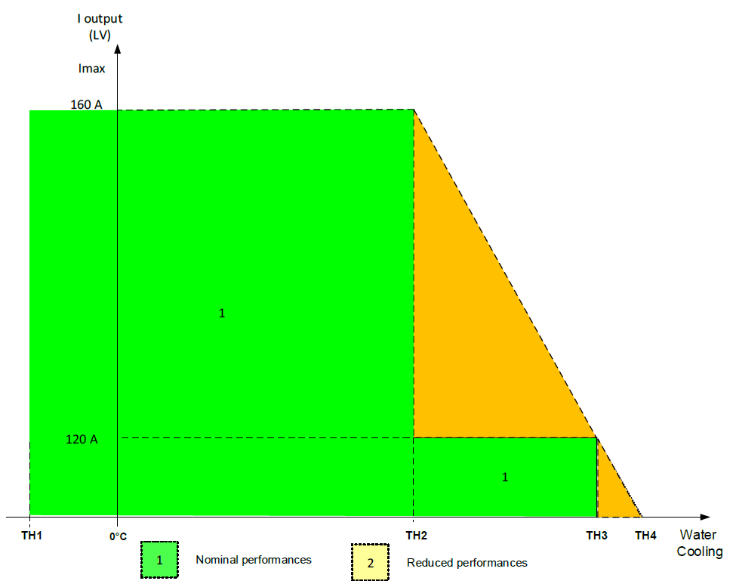
Thermal Derating Strategy
Derating regarding specification 5DH: → 100% output current / power below +60°C → 75% output current / power at +65°C → 0% output current / power above +70°C → linear interpolation between this operating points
Temperatures are coolant temperatures.
+60°C
+65°C
+70°C

Slide 23
Converter Control

Slide 24
LLC Ctrl.
Structure
xxxx

Slide 25
Smarter. Greener. Together.

